Slide 1
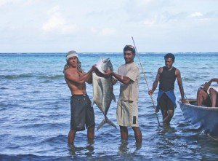
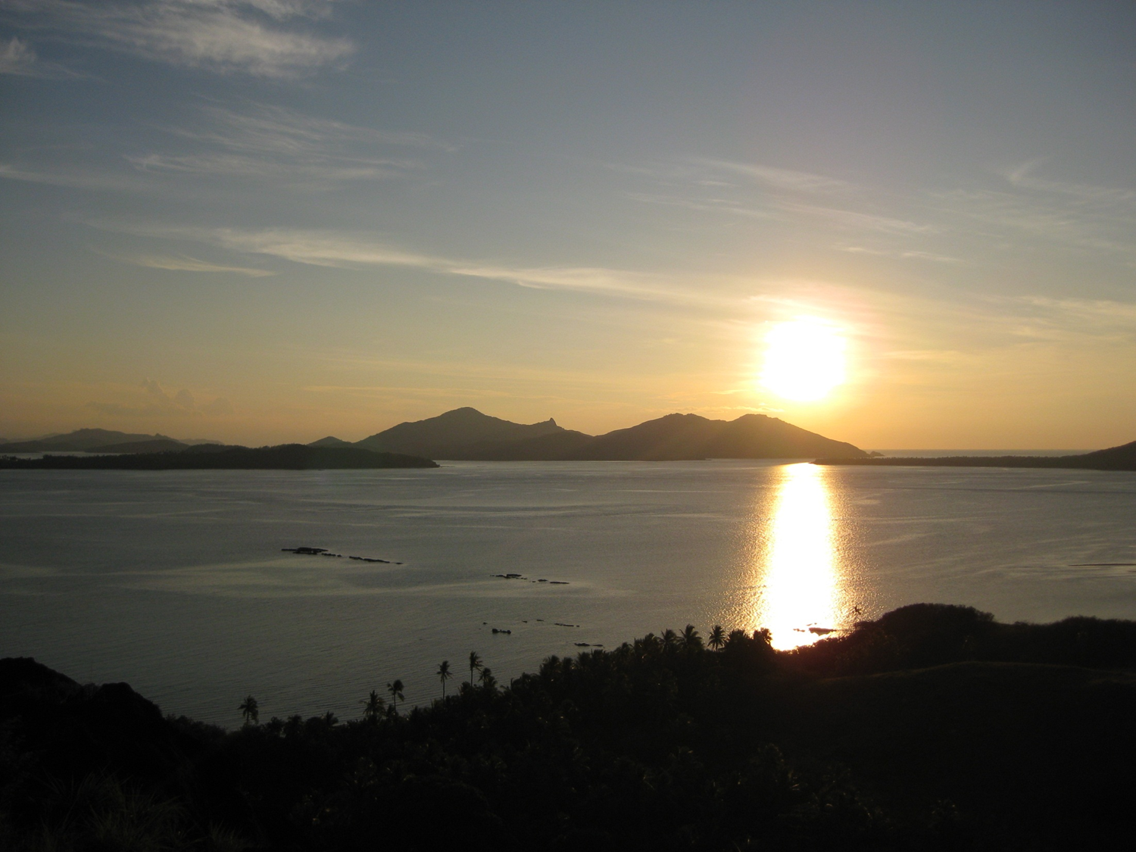
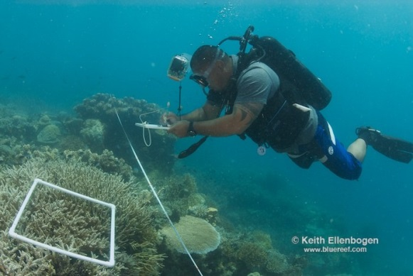
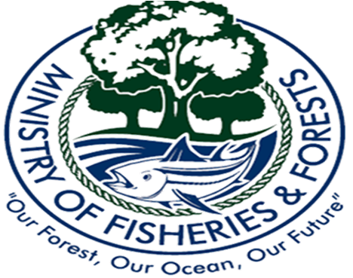
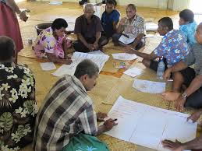
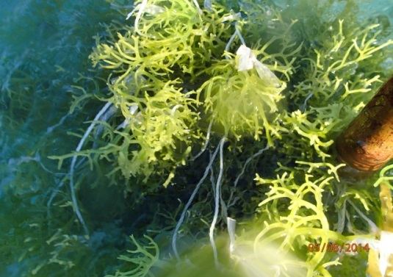
Coastal Resource Management in FIJI
Presentation to the Regional Seminar on Community-based Coastal Resource Management
Monday 13th October 2014
Melanesian Hotel, Port Vila, Vanuatu

Slide 2
Outline
Fiji-Background
Coastal Resource Management in Fiji
Challenges
Responses to the challenges…

Slide 3
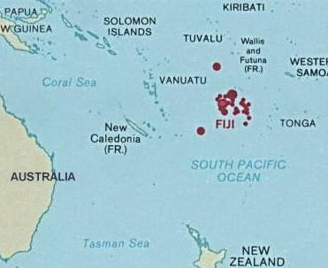
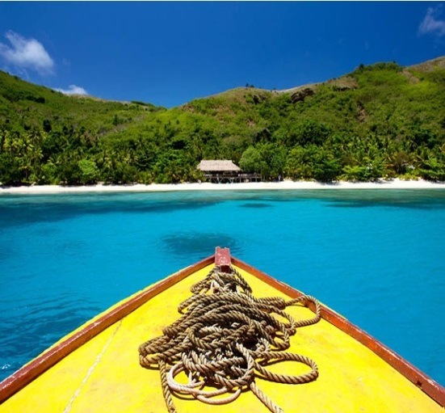
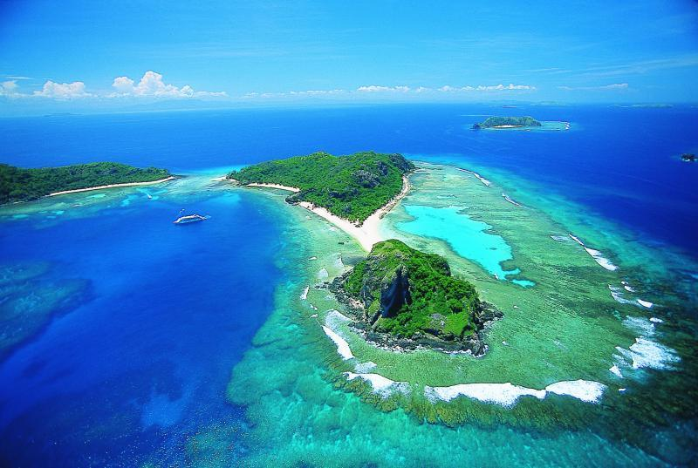
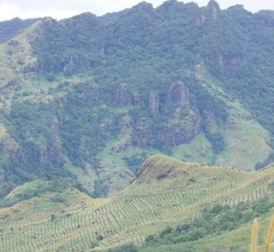
Fiji
PHYSICAL ENVIRONMENT
Location : Heart of the Pacific Ocean
Position : Long. 174⁰East/178⁰West of Greenwich; Lat. 12⁰S/22⁰South
Land Area : 18,331 km²
(Group of 300 islands; Agriculture Land: 4,280 sq. km; Forest area: 9,800 sq. km; arable land: 170,000 hectares )
Total sea area [Approx.] : >1.3million Sq. km
(EEZ 1.3 million sq.km.; Coastline 5,010km; Reef area 10,020 sq. km.; Mangrove area 385 sq.km)

Slide 4
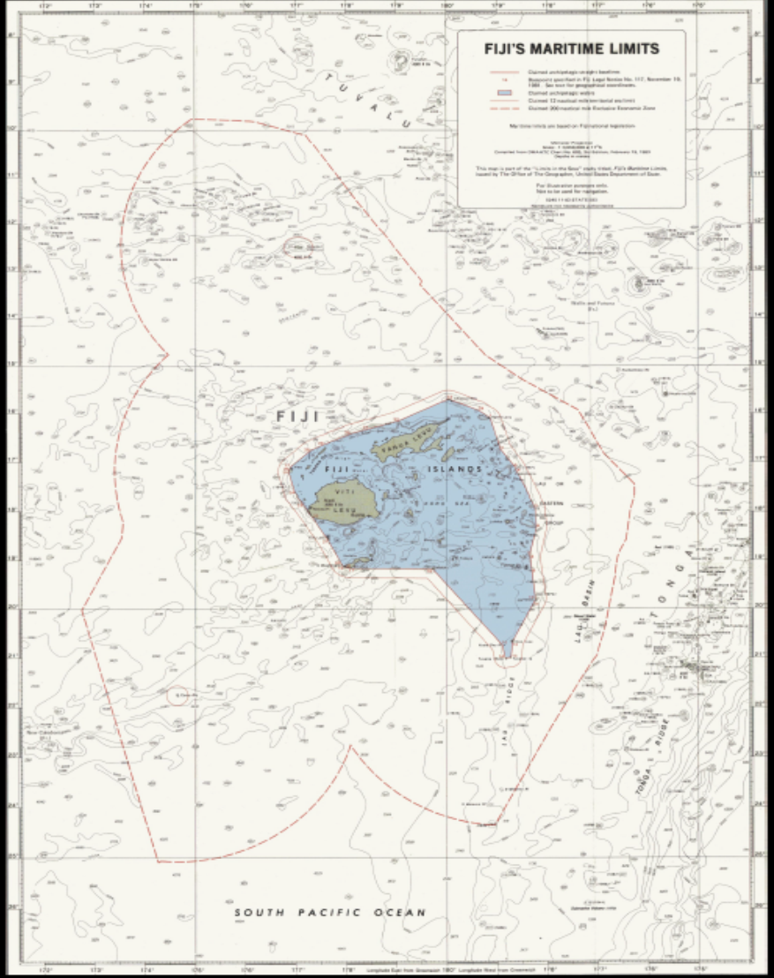
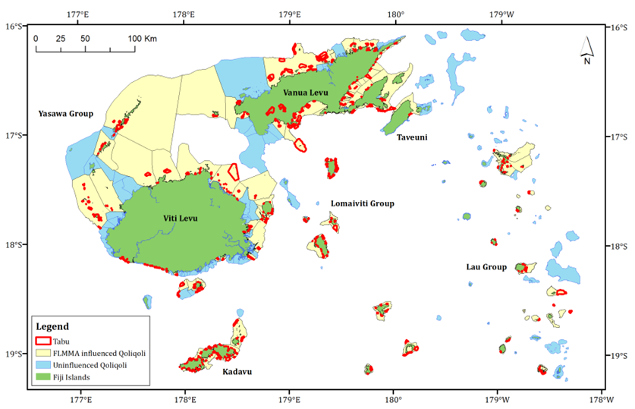
Maritime Limits
(As delimited under the Marine Spaces Act Cap 158A, 1978)
Archipelagic Waters:130,450 sq. km
Territorial Waters:45,000 sq. km
Exclusive Economic Zone:1.3 million sq. km
Customary Fishing Right Areas: 411

Slide 5
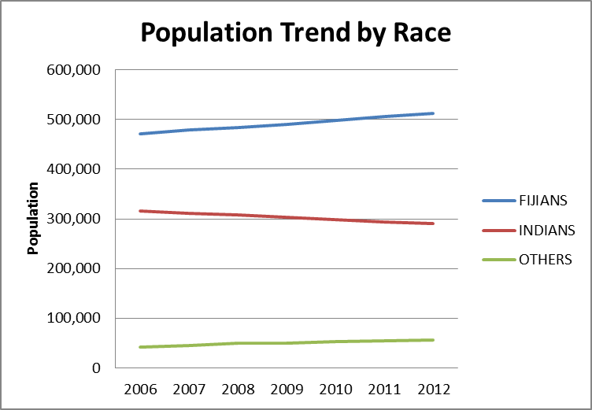
Socio-economic Profile
 | FIJIANS | INDIANS | OTHERS | TOTAL
2006 | 471,729 | 316,227 | 42,663 | 830,619
2007 | 478,571 | 310,570 | 45,377 | 834,517
2008 | 483,922 | 307,684 | 49,768 | 841,373
2009 | 490,888 | 303,875 | 50,650 | 845,462
2010 | 498,888 | 298,708 | 53,105 | 850,700
2011 | 505,273 | 294,240 | 54,778 | 854,290
2012 | 511,838 | 290,129 | 56,071 | 858,038
Population 837,271 (2007 census)
Population Growth rate 1.40%
Ethnic Breakdown
56.8% Fijians
37.8% Indians
5.7% Others
Religion
58.0% Christian
33.7% Hindu
7.0% Muslim
1.3% Others
 | 1996 | 2007
Rural | 415,582 | 412,425
Urban | 359,495 | 424,846

Slide 6
Sectoral Contribution to GDP
Fisheries Sector accounts for 3.0% of Fiji’s GDP
Bulk of export earnings for the sector is attributed to industrial fisheries comprising mainly of offshore fisheries suppliers and processors who generate 84% of total export earnings while the remaining 16% is derived from the export earnings in artisanal fisheries.
Notes:
The fisheries sector is one of the priority economic sectors for Fiji given its daily impact on the lives of our people and communities plus the important contribution to the country’s GDP, estimated at 3.18% with real domestic export earnings of FJD$205 million or 20.5% of all exports for the country as of September 2013.

Slide 7
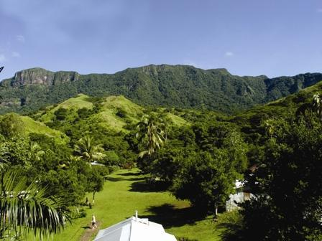
Fiji’s Climate Profile
Fiji enjoys a tropical South Sea maritime climate; the islands lie in an area occasionally traversed by tropical cyclones confined between November to April every year.
Temperatures average 22°C for the cooler months [May to October] while November to April temperatures are higher with heavy down pours.
In August mean maximum temperatures ranged from 26.2°C to 30.4°C, with daily maximum temperatures rising as high as 32.5°C.
Mean minimum temperatures ranged from 17.4°C to 24.6°C, with overnight temperatures falling as low as 13.5°C in the Northern Division.

Slide 8
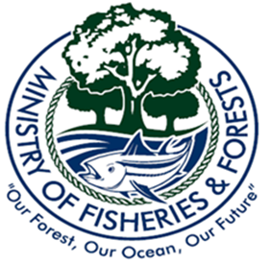

Slide 9
Coastal Resource Management in Fiji

Slide 10
Coastal Resource Management -Why important for Fiji?
Fiji is a coastal nation and its coastal resources are an important basis for stability and sustained growth
Coastal areas are of vital importance to Fiji society and its national development. Majority of urban centres villages located on the shore, along with much of the population, agriculture, industry and commerce.
Income from tourism and fisheries is directly tied to the condition and productivity of critical ecosystems and shoreline features such as coral reefs, beaches, seagrass beds and mangroves.

Slide 11
Food security and livelihoods
Coastal resources are essential for long-term food security and social livelihoods.
Many of Fiji’s coastal communities rely almost exclusively on fishing for food and income, with about half of rural households engaging in subsistence fisheries. According to more recent estimates, Fiji has about 43,000 subsistence fishers although this is likely vastly underestimated.

Slide 12
Fiji’s coastal habitats and ecosystems are of national and international significance
Fiji's coastal environment is made up of an assemblage of resources including coral reefs, mangroves, beaches, and forests;
These resources form the basis of Fijian culture, employment, and food supply and therefore need to be well maintained for future generations;
In addition, tourists travel thousands of miles to enjoy Fiji’s National Heritage.

Slide 13
Challenges

Slide 14
Coastal areas and the resources they support are threatened by overuse and degradation
inappropriate agricultural activities
mining
sewage pollution
inappropriate solid waste disposal
fishing activities
use of destructive fishing practices
beach sand mining
building of jetties and groynes
commercial harvesting of coral
soil erosion and siltation
improper disposal of industrial waste
natural hazards such as climate change and sea level rise and hurricanes.

Slide 15
From the Fisheries perspective, effective coastal resource management has in the past been constrained by such factors as :
absence of a consolidated national legal and administrative framework;
the scarcity of resources within the Government system to effectively execute and implement coastal resource management measures
the lack of an INTEGRATED APPROACH & PLANNING to coastal resource management

Slide 16
How has Fiji Fisheries responded to the Coastal Resource Management Challenge?

Slide 17
A number of coastal management initiatives can be seen in Fiji (most of which are implemented through NGOs in collaboration with the Department):
marine conservation and marine resource management,
community based adaptive management
assisting communities in developing localized coastal management plans;
focuses on good governance,
payments for ecosystem services, and
pilot climate change adaptation in an integrated approach to exposure sectors, and internalize climate change adaptation at rural communities;
effective management of natural and coastal resources;
improving livelihoods and climate proofing coastal communities
helping communities manage their mangrove and associated coastal ecosystems to build resilience to the potential consequences of climate change and variability on coastal areas.

Slide 18
Department of Fisheries Initiatives
Stock assessments of inshore fisheries to ascertain status of resources (Marine Resource Inventory Surveys)
Community-based projects: alternative livelihood opportunities (CB Spat collection program; seaweed farming; aquaculture)
Community Management Planning
Fisheries impact assessments (FIA) to ascertain impacts of foreshore development on coastal fisheries
Deployment of fish aggregating devices (FADs) to encourage fishing around FADs with the aim to relieving fishing pressure off from reefs
Establishment of seed banks for overexploited fish stocks-Fiji in this case has established giant clam nurseries; the introduction of sandfish cage fattening for the purpose of reseeding fishing grounds
Biodiversity enhancement through the reef enrichment initiative-reef replenishment activities : mangrove replanting, giant clam reseeding & sandfish translocation, coral farming, etc.)

Slide 19
Fisheries Management:
Licensing/Regulations/Awareness
Fisheries Act Cap 158 : Provision for regulation of fishing
Regulations for size and weight restrictions; seasonal catch; net and mesh size;
Regulating provisions for issuance and cancellation of licenses
Appointment of Honorary Fish Wardens
Imposing bans on protected species-turtles, humphead wrasse
Promoting ecosystem based management approaches
Awareness-Fish Warden Training; Community Workshops etc
M&S (Monitoring and Surveillance)
Coordinated enforcement operations with Police and Navy
Monitoring of export consignments

Slide 20
Local level management
Traditional management measures at the community level
Permitting system (Consent) - where Fijian people determine which commercial fishermen are allowed to fish in their areas and impose restrictions on each fisher;
Customary marine tenure systems-“kanakana”/”qoliqoli”
Marine Protected Area management spearheaded by local NGO’s whereby communities are given the opportunity to manage their customary fishing rights areas through protected area management-FLMMA network
Reef restoration-coral planting –Walt Smith (on a small scale; but doing this as a means of replenishing certain coral species in the wild)
Adopting EBM at community levels-WWF at the forefront of this;
Traditional ‘tabu’ periods of harvesting certain marine animals-during the death of a high chief

Slide 21
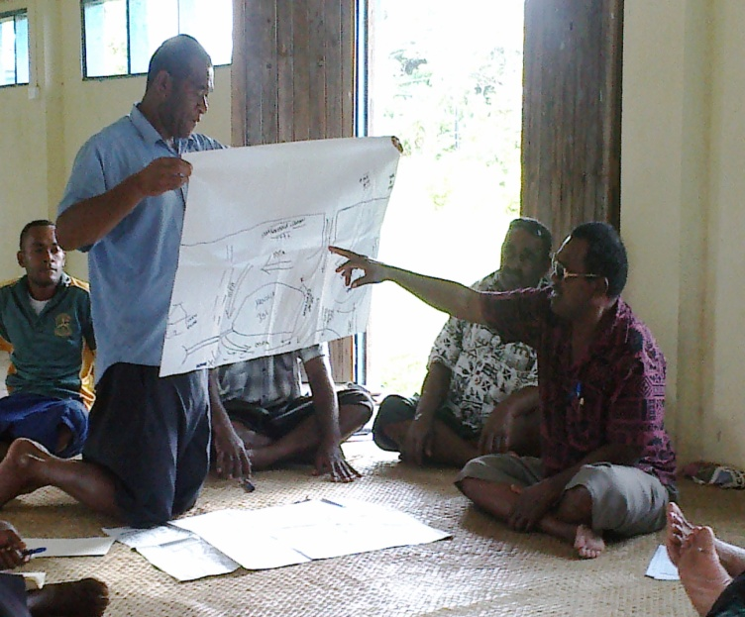
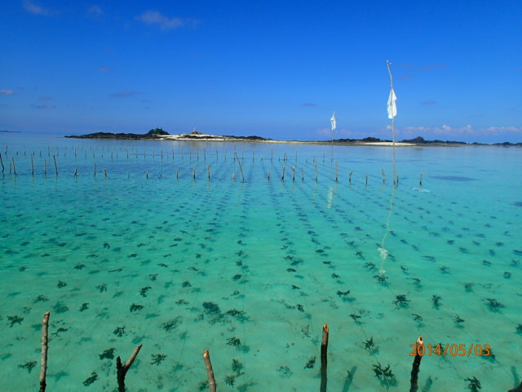
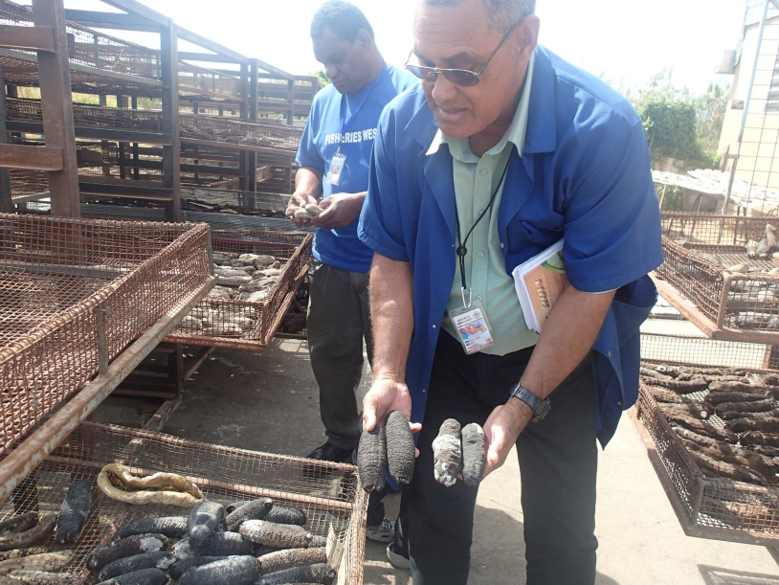
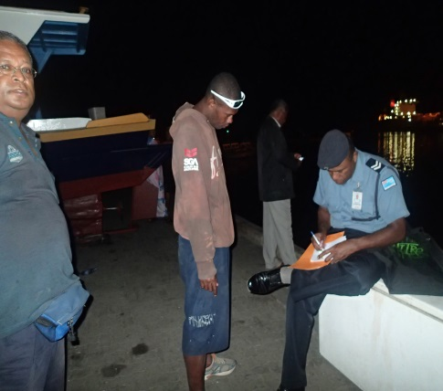
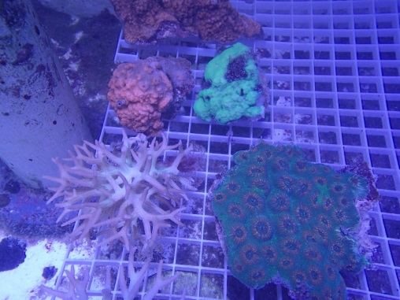
Coastal Resource Management in Action
Community Management Planning
Marine Resource Survey
Seaweed Farming
Monitoring & Inspection
Law Enforcement
Coral farming

Slide 22
Case Study: Sandfish (Holothuria scabra) production and sea-ranching trial in Fiji
Great interest in the Pacific islands region in restoring depleted sea cucumber fisheries with hatchery-produced juveniles
ACIAR funded projects in Fiji to transfer technology for culturing and sea ranching of sandfish (Holothuria scabra, known locally as ‘dairo’).
An extensive seagrass bed on a shallow sand flat in front of Natuvu village, Vanua Levu, met the criteria for suitable habitat for sea ranching, and the community was committed to the research.

Slide 23
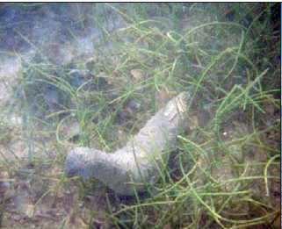
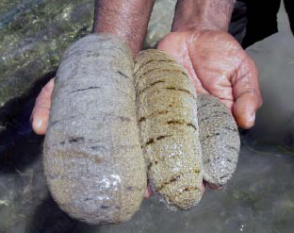
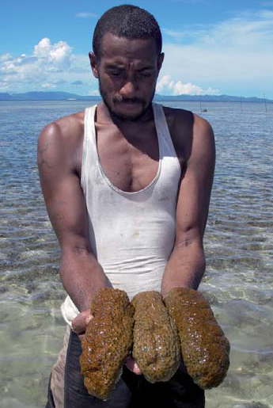
The Natuvu community ceased harvest of sandfish from the wild prior to the project starting, and also declared a marine protected area (MPA) around the sea-ranching site.
An unanticipated benefit of the project was an increase in other valuable sea cucumber species in their MPA, which were harvested for a one-off community fundraising event.
..\LITERATURE\sandfish natuvu report (2).pdf

Slide 24
In continued recognition of the need to manage and conserve the dwindling sea cucumber resources of Fiji, the Department has put together a Draft Sea Cucumber Management Plan with assistance from SPC
Overall Objective
To provide ecological sustainable management of, and to establish an effective, conducive and enforceable management structure for the Fiji sea cucumber fishery.
Commence a logical adaptive approach to the management and optimal sustainable utilization of sea cucumber resources;
Build and maintain stocks at biological sustainable levels;
Protect diversity of the marine environment;
Ensure adequate provisions of resources for the implementation, monitoring and enforcement of the fishery Plan;
Ensure accountability to all stakeholders; and
Support and maintain a profitable and sustainable sea cucumber fishery ensuring the fishery benefits communities of Fiji.

Slide 25
Government Investment, Policies Commodity plans & more initiatives…
Investment into 11 Capital projects & Operational Budgets for the Department of Fisheries: $11.4 million.
Main focal areas: Food Security, Poverty Alleviation, Alternative Livelihood Projects, Capacity Building of Fishermen, Licensing , Provision of Services (Ice plant), Coastal Fisheries Development .
Current Regulations: Turtles, Humphead Wrasse.
Development /Commodity Plans: Shark, Cetaceans, Sea Cucumber, Fiji Sea Turtle Recovery Plan and Tuna Management Plan.
Policies/Plans underway: Protection of Spawning Aggregation Sites, Gazettal of Marine Protected Areas

Slide 26
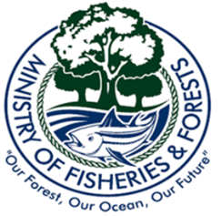
Inter-Government Agency Initiatives…
Formulation of an integrated approach to coastal resource management -consolidated Integrated Coastal Management Framework 2011. The framework produced by the Fiji Department of Environment reviews current coastal conditions in the context of
tourism development, coral reef degradation, siltation and erosion, harvesting of marine resources, waste management, coastal reclamation and construction and natural disasters among others
assesses the current legal and institutional governing framework to recommend proposals for action and policy towards sustainable coastal resource management for Fiji.
The 2005 Environment Management Act (EMA) stipulates the development of a coastal management plan under Section 3(8).
Strengthening work and efforts in collaboration with its partner non-governmental organizations in addressing coastal resource management
particular significance is the work of the Fiji Locally Managed Marine Area Network (FLMMA). The network has been pivotal in coastal fisheries management in Fiji.
FLMMA has expanded rapidly throughout Fiji, aiding communities in the implementation of management tools utilised within the qoliqoli (customary fishing grounds).
Most notable is a growth in the use of tabus, traditional no‐fishing zones. Community‐imposed tabu areas are not explicitly recognised in the legal framework for coastal fisheries management. This is an area needing improvement for Fiji, as the process of legalizing these protected or tabu areas through the gazetting process needs reviewing.

Slide 27
NGO’s-Local and Regional
Support towards Government Initiatives towards Sustainable Management of Marine & Terrestrial Resources.
Funding, Capacity Building, Training, Scientific Research, Technical Advisory Services.
Eg: FLMMA Network – 10 years – FJ $6 million.

Slide 28
Planning 4 Tomorrow!!
An INTEGRATED APPROACH!
The current approach to managing Fiji’s precious coastal and marine resources is a combination of sectoral government policies and local level initiatives. These initiatives are important and in some cases have achieved significant, positive results!
ICRM is a continuous and dynamic process that unites government and the community, sciences and management, and sectoral and public interest in preparing and implementing an integrated management plan for the protection and development of our coastal ecosystems and resources!

Slide 29
Vinaka Vakalevu!!

