Slide 1
Regional Seminar on Community based Coastal Resource Management
Project for Promotion of Grace of Sea in Coastal villages – Phase 2
13 -16 October 2014
Melanesian Hotel, Port Vila
Vanuatu

Slide 2
Current Status of Coastal Fisheries Resource Management in Samoa
Ulusapeti Tiitii – PFO Inshore & Aquaculture
Autalavou Tauaefa – PFO Advisory

Slide 3
Outline
Strategies/Plans
Fisheries Policies
Fisheries Management
- Subsistence/Coastal Fisheries
- Community Fisheries
- Aquaculture
Outcomes
Challenges

Slide 4
Institutional Structure
FISHERIES
DIVISION
Administration
& Fish Market
Aquaculture
Inshore Section
Advisory/Extension
Section
Offshore &
Enforcement
Sections

Slide 5
Ministry Strategies/Plan
Agriculture Sector Plan 2011-2015
- Vision: AGRICULTURE FOR FOOD AND INCOME SECURITY
- Theme: “farming and fishing first”
- Overall Goal/Objective: To revitalise the agriculture sector to increase its relative contribution to the national GDP from its current level of 10% to 20% by 2015

Slide 6
Fisheries Strategic Objectives
Enhancing the capability of Samoa in meeting its need for adequate supply of fisheries as to sustain food security
Promote long-term sustainability of fishery resources by strengthening the legal framework, management capability and leadership capacity of Fisheries Division and stakeholders.
Maximizing economic benefit for Samoans through viable developments in partnership with fishers, donors, lending institutions and Government.
Sound scientifically and technologically based information and decisions thus strengthening the management and development of fisheries sector.
Improve the ability and resources of the Fisheries Division to provide service of the highest quality as to ensure stakeholder satisfaction.

Slide 7
Our Regulations
Legislations:
- Fisheries Act 1988,
- Local Fisheries Regulations 1995
- Fisheries (Transshipment Regulations 2003)
- Fishing (Scuba Fishing) Regulations 2003
- Fisheries (Ban of Driftnet Fishing Act) 1999
- Fisheries (Fees & Forms) Regulations 2000
- Fisheries (Vessel Monitoring System Regulations 1999)
Mandated under the Fisheries Act 1988 with scopes as:
- To promote the conservation, management and development of the fisheries of Samoa;
- To promote the exploitation of the living resources of fishery waters;
- To promote marine scientific research;
- To promote the protection and preservation of the marine
environment.

Slide 8
Our Management Plans
Tuna Management and Development Plan (TFMDP)
Coastal Fisheries Management & Development Plan (CFMDP)
Aquaculture Management & Development Plan (AMDP)
Village Fisheries Management Plan (VFMP)
- Fisheries Bylaws
Sea Cucumber M&D Plan (draft)
Trochus M&D Plan (draft)

Slide 9
Coastal Fisheries
Most important as most of the population (75%) reside on coastal areas and depend on fisheries for daily protein - subsistence (consumption) and artisanal (earning income for some fishing families)
2000: Total seafood consumption was est. 9971 tonnes with value of over $62million / year in which $45 million was caught by village fishers
2006: Average per capita consumption per year = 59.4 Kg, (163g/ day) with total consumption per year = 10,508mt
2012: socio-economic survey estimated a total of 9,066.32 tons of fish and 7,804.42 tons for invertebrates
With a growing population and pressures for speedy development, uncontrolled harvesting of fish and wildlife resources, natural disasters and impacts of climate change, these areas are under threat.

Slide 10
Our major concern
Overfishing
Population growth (increasing demand for fresh seafood)
Destructive fishing methods
explosives
poisons
Use of introduced, effective and non-selective techniques (wire fish fences, gill nets)
Loss of inshore nursery habitat (mangroves and marshes has been reduced by reclamations, logging and drainage, cyclones and climate change)
Inadequate use of fisheries management tools and regulations
ineffective unless they have the support of the community

Slide 11
Our Immediate Action
Deliver the results to the communities and the Government and encourage them to feel responsible
The Community Based Fisheries Management Programme (CBFMP) was established in 1995
This programme empowers community villages to manage their own inshore resources through establishment of Village fisheries management plans, bylaws and marine reserve areas

Slide 12
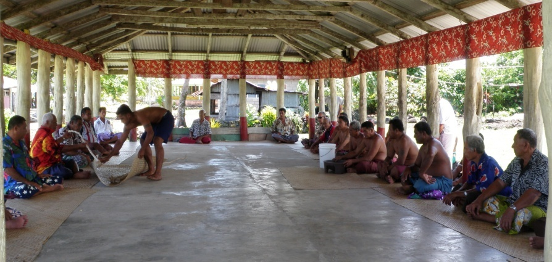
COMMUNITY BASED FISHERIES MANAGEMENT PROGRAMME (CBFMP)
Establish Villages Fish Reserves
- establish Management Plans for each village
Process:
I) First formal
Meeting with
Village council
First meeting: Sasina

Slide 13
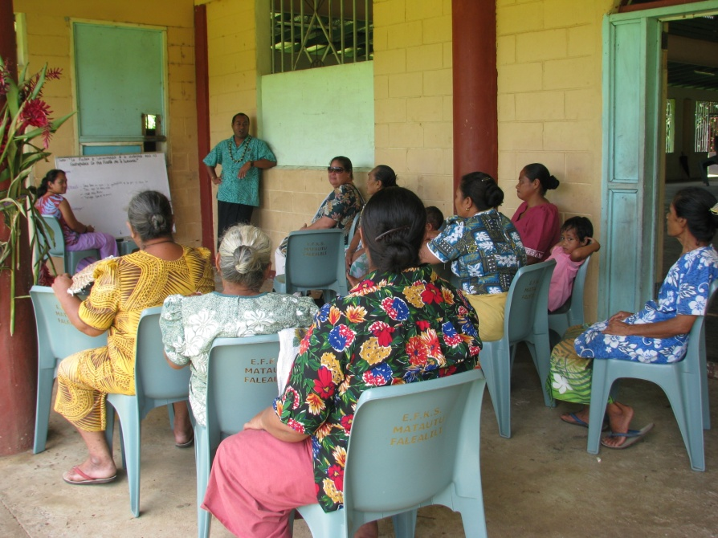
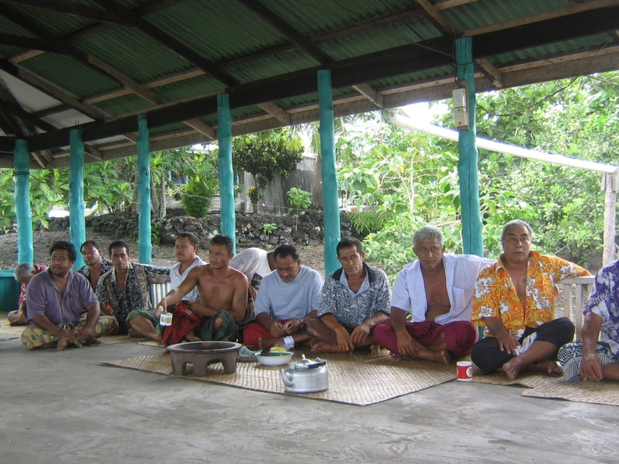
CBFMP…..
ii) Groups’ Meetings/
Consultation
- gather information to formulate village fisheries management plan
Women’s Group – Matautu, Falealili
Chief’s Group – Sataua, Savaii

Slide 14
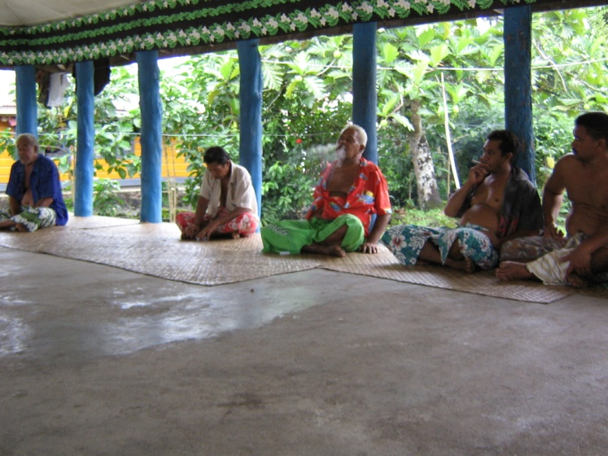
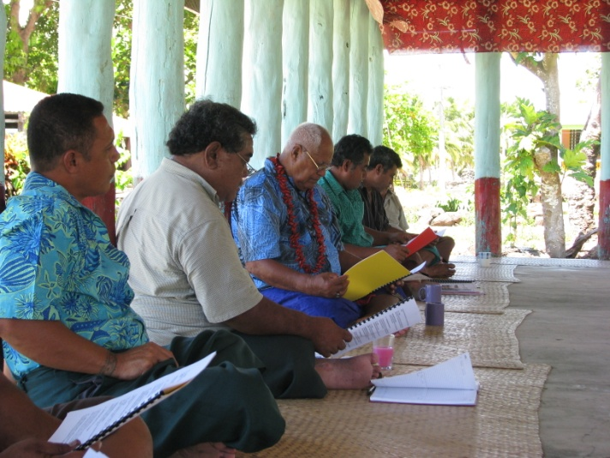
CBFMP…….
iii) Village Advisory Committee Meeting
iv) Final formal Meeting with Village council (approve Management plan)
- FD draft Management Plan & present to the Fono
- FD/MAF draft by-laws for each village
Fisheries Advisory Committee
Tafagamanu, Lefaga
Final meeting: Sasaai

Slide 15
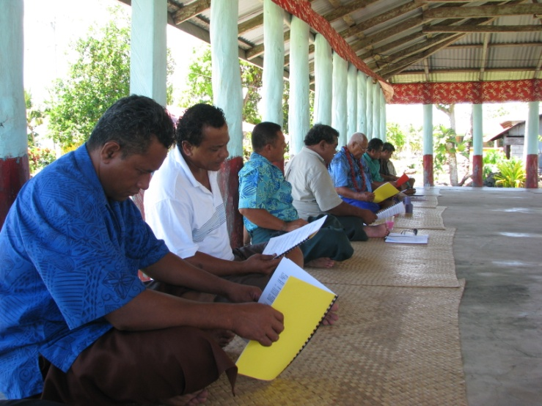
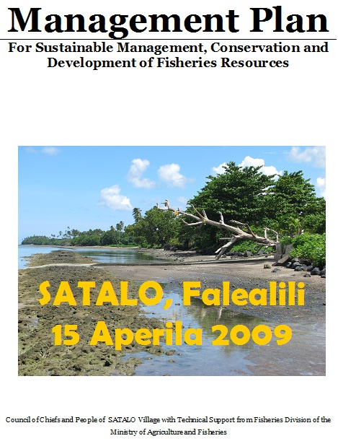
Step 4: Final Meeting/Fono with Village Council
Discuss the Management Plan
Village Council approve the Management Plan
FMAC oversee the conducting of their undertakings in the M.Plan

Slide 16
Main undertakings in the Management Plans
Establish a Fish Reserve Area
Ban destructive fishing methods (dynamites, poisons, chemicals)
Ban Small Mesh Size Fishing Nets
Ban disposal of Rubbish in the sea & coastal areas
Ban coral smashing fishing
Ban fishing or activities within the fisheries reserve
Ban fishing of small sized fish and shellfish
Ban scuba gears
Collect and destroy crown of thorns star fish
Climate change Adaptation and reef resilience

Slide 17
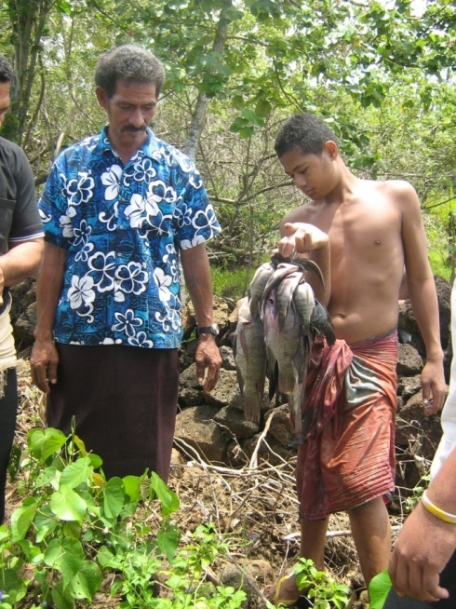
Monitoring activities
Fisheries resources and habitat assessment to determine
- establish of fish reserve areas
- substrate coverage (live coral, bleached, abiotics, algae, seaweed)
- biodiversity importance (aggregate spawning sites)
- fish biomass and density
- market and road site surveys for domestic landings

Slide 18
Monitoring activities
Stock enhancement
- restocking and translocation of suitable species (giant clams and Trochus
Coral reef rehabilitation
- coral replanting
- formation of fish houses
Sea cucumber status assessment
- current status of existing stock

Slide 19
Monitoring activities
Fish Poisoning assessment (Ciguatera)
- collecting algae samples from selected sites
- Microscopic analysis to determine the presence of the toxic dinoflaggellates, Gambierdiscus toxicus
Crown of thorns starfish assessment
- tsunami impacted areas
- clean up campaigns

Slide 20
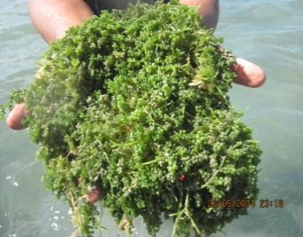
Development activities
Promote Aquaculture to village communities, churches and individual farmers
- Tilapia farming
- Sea grape culture
- Giant clam cycle
- Trochus/aliao
- Aquaponic system
- Integrated farming

Slide 21
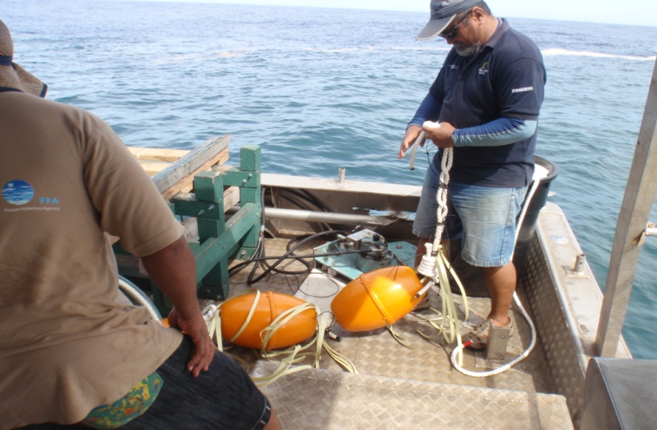
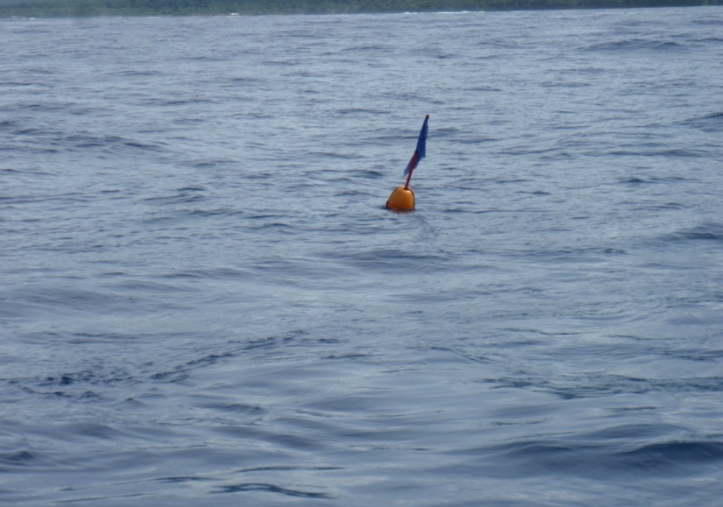
Development activities
Promote diversification of fishing technology
- Coastal Fish Aggregating Devices (FADS)
- Integrated fish cum vegetable farming
- Alternative livelihood and adaptations to local communities

Slide 22
MONITORINGS by Various Sections
Advisory/
Extension
Section
6 Monthly Reviews of villages Management Plans;
Awareness and Capacity Building
Inshore
Sections
Initial inshore survey and annual assessments and
monitoring
Aquaculture
Monitoring of tilapia, giant clams and other species
Enforcement
Sections
Enforcement of Fisheries Regulations and bylaw cases reported by villages

Slide 23
Current Status
100 villages with Management Plans
71 fish reserves
32 sites planted with corals
78 village bylaws
28 sites stocked with trochus/aliao
6 sea grape farms/limu fuafua
34 tilapia farms (individual/communities)
22 giant clam farms
6 districts with coastal FADs

Slide 24
Challenges
Challenges
Staff turnover
Resources (funding/tools)
Regulations (enforcement)

Slide 25
Outcomes
Strong engagement of communities in fisheries activities (i.e. Monitoring – fish reserves/removal of COTs, site assessements of tilapia/seagrape)
FD and Communities to work together in seeking for donors to carry out fisheries activities
Encourage co-management in enforcing regulations and village bylaws.

Slide 26
Supporting partners
JICA – Follow up projects
NOAA - Two Samoas Reef resilience
SPREP – Two Samoas Reef Resilience
SPC – Climate Change Adaptation
GIZ – Climate Change Adaptation
UNDP GEF SGP – village small grant project, etc,
- ACIAR – community-based tilapia aquaculture and Seaweed diversification

